Slide 1
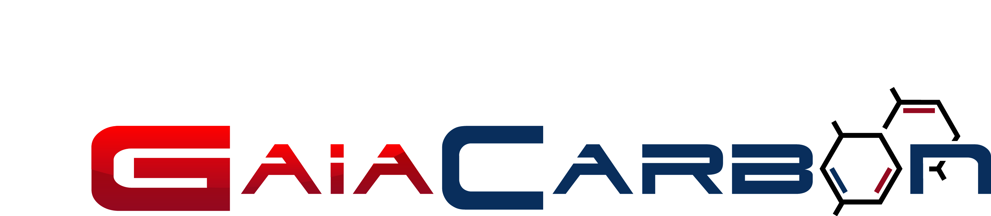
GAIA CARBON PTE LTD
Date: 02 Jan 2024

Slide 2
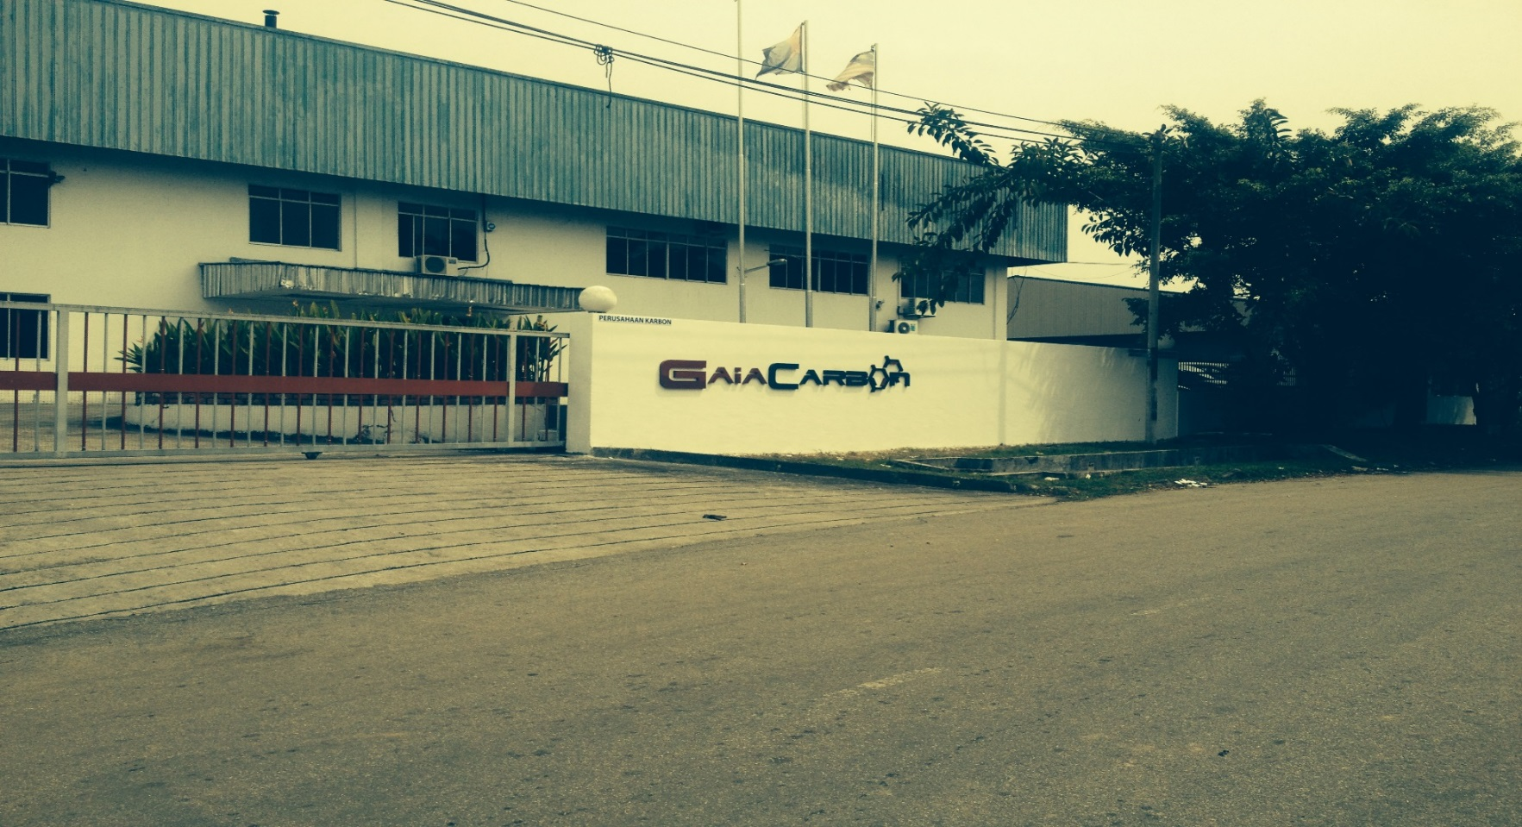
Introduction
Gaia Carbon produces premium-quality activated carbon via self-designed unique multi-point steam activation to suit a diverse range of client’s needs with annual capacity of 5000MT.
Head Quarter : Singapore | Plant : Malaysia & Indonesia

Slide 3
Applications
3 major applications:
Liquid Phase
Gas Phase
Gold Recovery

Slide 4
Liquid Phase
Drinking Water | Waste Water Treatment | Industrial Process Purification
Disinfection | Removal of VOCs and other organic compound | Agricultural
Mercury removal | Removal of biological as and chemical oxygen | Mining
Heavy metal removal | Removal of trace organics | Electroplating
Adsorption of Volatile organic compounds (VOCs) |  | Dry cleaning
 |  | Food and beverage
 |  | Purification in steam
 |  | Mercury removal from hydrocarbons
 |  | Precious metal recovery and trace removal
 |  | Purification of glycols, organic compounds, amines

Slide 5
Gas Phase
Indoor Air | Industrial Process Gas
Air filters for airborne dust and allergens | VOCs removal from industrial air emission
Volatile organic compounds (VOCs) adsorption | Respirator masks
Deodorization | Mercury, sulphur and other organics removal from flue gas treatment plants
 | Removal of hydrogen sulphide, ammonia, VOCs etc removal from the sewage plants and purification of carbon dioxide gas in beverage industry
 | Formaldehyde removal from chemical processing plants including paints

Slide 6
Gold Recovery
GaiaGold is widely used in gold recovery applications. Steam activated carbon has large pore volume that makes it highly suitable for recovery of gold in Carbon in leach (CIL), Carbon in Pulp (CIP) and Carbon in Column (CIC). These product offers high rates of gold loading and elution, low platelet contents and consistent in circuit performance. Its superior hardness and attribution resistant ensure minimum breakdown of carbon in the circuit to avoid the loss of gold and operation delays
Benefits
Maximum gold loading
Rapid adsorption kinetics
Consistent Performance
Strictly Controlled Size Distribution
Excellent attribution resistant
Low platelet Concentration

Slide 7
GaiaGold Specification
Analysis | GaiaGold A260 | GaiaGold A280
CTC Activity | 50% Min. | 55% Min.
Ash Content | 3% Max. | 3% Max.
Moisture, as packed | 5% Max. | 5% Max.
Ball Pen Hardness | 99% Min. | 99% Min.
Apparent Density | 470-510 kg/m3 | 460-500 kg/m3
Attribution (A.A.R.L) | 2% Max. | 2% Max.
Platelet (A.A.R.L) | 7% Max. | 7% Max.
Mesh | 6x12 or 6x16 | 6 X 12 or 6x16
Packaging :
550 kg Woven bag
25 kg PE bag

Slide 8
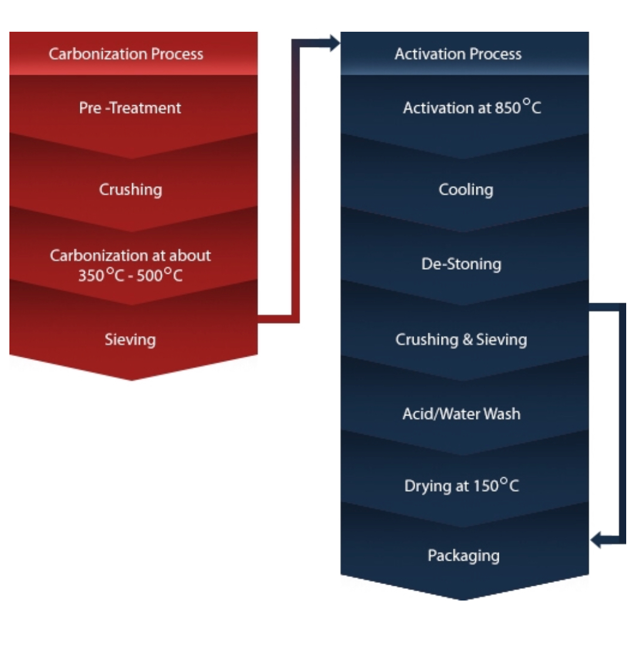
Manufacturing Process

Slide 9
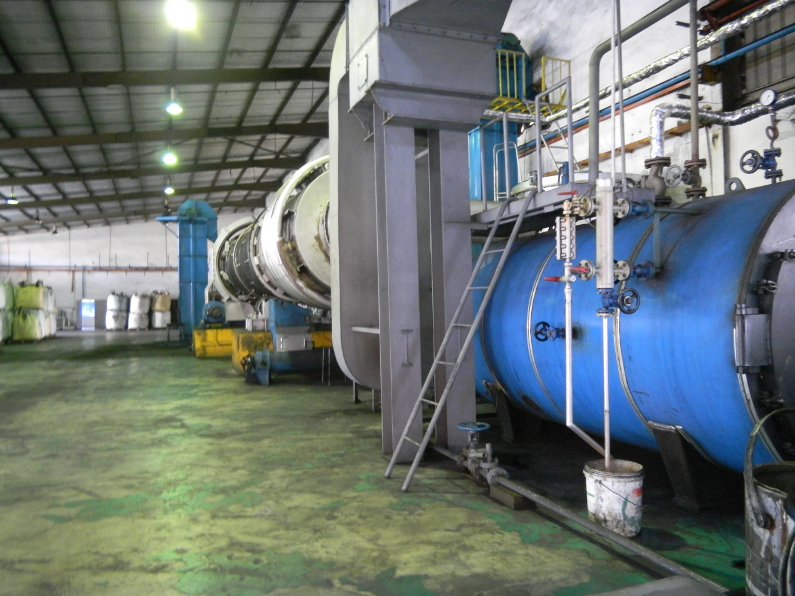
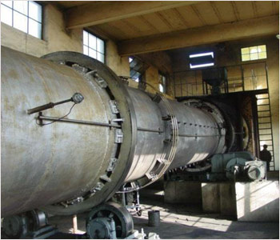
Rotary Kilns

Slide 10
Key Export Countries
Japan
Korea
China
Vietnam
Indonesia
Malaysia
Myanmar
Singapore
Taiwan
Bangladesh
USA
Australia

Slide 11
Customers
Application | Customers
Liquid Phase | Taiwan semiconductor(TSMC) Formosa plastic Veolia water Ocean Mineral water Dr. Who Mineral water Kurita Petronas Taiwan Sugar Corporation etc
Gas | Petronas Osaka Gas Chemical Perco Plastics AAF International Camfil Group etc
Gold Recovery | Malaysia : CMNM mining group Myanmar: National Prosperity Company Australia : Sell via agent

Slide 12
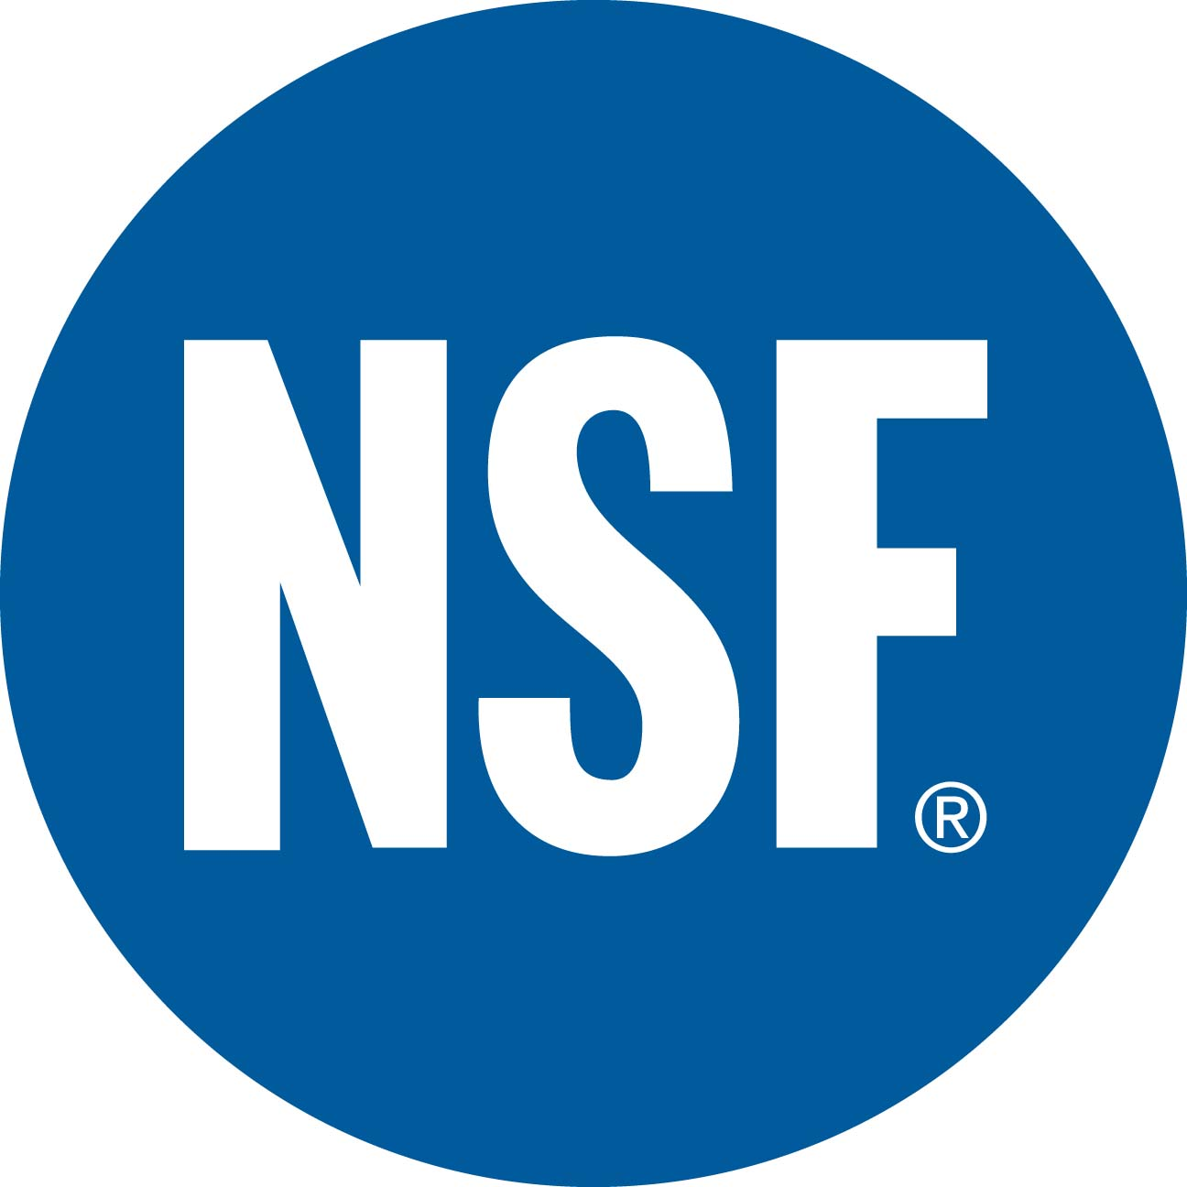

Certifications
NSF
Halal
EN12915

Slide 13
THANK YOU!

